Slide 1
Lecture 15
Statistical Inference (continued)
The Likelihood Function and Maximum Likelihood Estimators

Slide 2
Data: 2009/2010 Survey of peasant workers in Beijing
Education | Number of Household Members | Insurance | Contract | Monthly Household Income | Monthly Household Consumption
教育 | 家庭 人口数 | 社会保险 | 用工 合同 | 家庭月收入 | 家庭月消费
2 | 2 | 0 | 0 | 89000 | 300
2 | 4 | 0 | 0 | 35000 | 400
1 | 5 | 0 | 0 | 3200 | 50
3 | 3 | 0 | 0 | 21000 | 350
1 | 4 | 0 | 0 | 40000 | 750
3 | 3 | 0 | 0 | 1500 | 30
4 | 4 | 0 | 0 | 34000 | 1000
3 | 6 | 0 | 1 | 4600 | 200
... | ... | ... | ... | ... | ...
an observation
Education (教育): 0=no education (未受教育), 1=primary school (小学),
  2=middle school (初中), 3=high school (高中),
4=junior college (专科), 5=college (本科)
Notes:
dfghdfghfdghgfhdfghdfgh

Slide 3
Basic Concepts
Population (总体) & Sample (样本)
  Population: the set of all units of interest in a particular study.
  Sample: a subset of the population.
Sample:
1419 peasant workers in Beijing
being surveyed
Population:
all peasant workers in Beijing
Notes:
dfghdfghfdghgfhdfghdfgh

Slide 4
Basic Concepts
Parameter (参数) & Statistics (统计量)
  Parameter: measurement of population
  Statistics: measurement of sample
Statistics:
Mean monthly household income for 1419 peasant workers in Beijing being surveyed
Proportion of having social insurance for 1419 peasant workers in Beijing being surveyed
Parameter:
Mean monthly household income for all peasant workers in Beijing
Proportion of having social insurance for all peasant workers in Beijing
Notes:
dfghdfghfdghgfhdfghdfgh

Slide 5

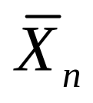
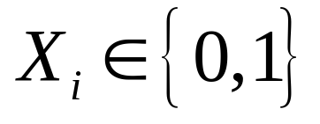

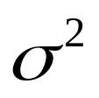
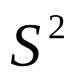
Population Parameters and Sample Statistics
Population Mean:
Sample Mean:
  Special case:
  Population Proportion:
  Sample Proportion:
Population Variance:
Sample Variance:

Slide 6

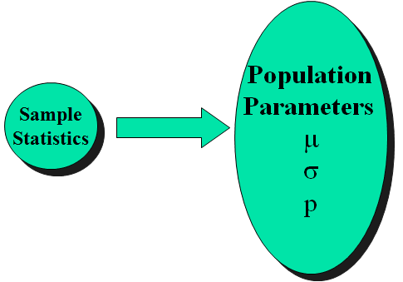
Statistical Inference
To understand the population parameters through the sample statistics.
Notes:
dfghdfghfdghgfhdfghdfgh

Slide 7
Why do sampling (抽样)?
Possible Reason 1:
Time or budget does not allow investigation of all units in the population.

Slide 8
Why do sampling?
Possible Reason 2: Infinite population
Infinite populations are often associated with an ongoing process that operates continuously over time. E.g.
  parts being manufactured on a production line;
  transactions occurring at a bank;
  telephone calls arriving at a technical support center;
  customers entering stores.

Slide 9
Parametric Inference
The probability distribution which generated the observed data is completely known except for the values of one or more parameters.

Slide 10


E.g. The distribution of the logarithm of monthly household income for all peasant workers in Beijing is assumed to be a normal distribution with mean and variance , but the exact values of and are unknown.
E.g. The distribution of the number of peasant workers in Beijing with social insurance is assumed to be a Binomial distribution with parameter p, but the exact value of p is unknown.

Slide 11



The set of all possible values of a parameter
or a vector of parameters is called the parameter space.

Slide 12
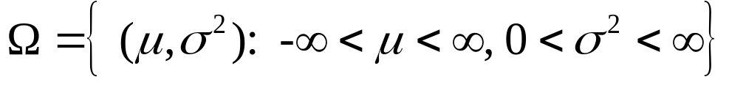
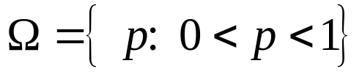
E.g. The distribution of the logarithm of monthly household income for all peasant workers in Beijing is assumed to be a normal distribution with mean and variance , but the exact values of and are unknown.
E.g. The distribution of the number of peasant workers in Beijing with social insurance is assumed to be a Binomial distribution with parameter p, but the exact value of p is unknown.

Slide 13

The Likelihood Function
Suppose that random variables X1,...,Xn form a random sample of size n from some distribution with parameter .
When the joint p.d.f. is regarded as the function of given the observed values x1,…,xn, it is called the likelihood function.

Slide 14



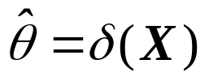

Statistical Inference Type 1: Point Estimator (点估计)
Specific Case: Maximum Likelihood Estimators
For each possible observed vector x=(x1,…,xn), let denote a value of for which the likelihood function is a maximum.
Let be the estimator of θ. This estimator is called the maximum likelihood estimator of θ.
Abbreviation: M.L.E. --- maximum likelihood estimator or maximum likelihood estimate

Slide 15
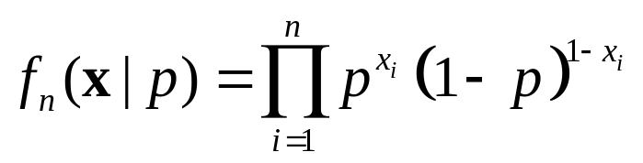
Example. Sampling from a Bernoulli Distribution
Suppose that random variables X1,…,Xn form a random sample from a Bernoulli distribution for which the parameter p is unknown.
For any observed values x1,…,xn, the likelihood function is

Slide 16
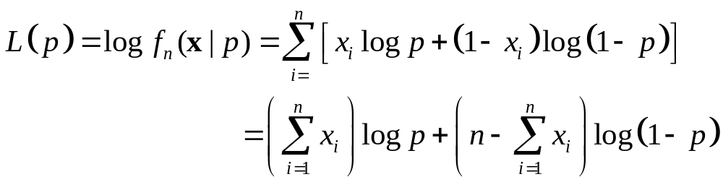

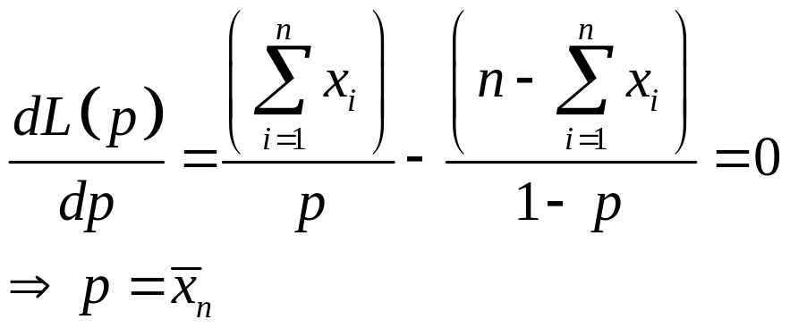
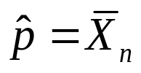
The logarithm of the likelihood function is
To find the value of p which maximizes and thus maximizes L(p),
So the M.L.E. of p is

Slide 17

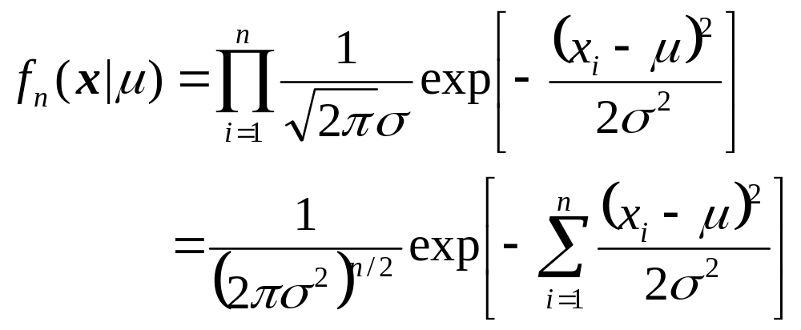
Example. Sampling from a Normal Distribution
Suppose that random variables X1,…,Xn form a random sample from a normal distribution for which the mean μ is unknown and the variance is known.
For any observed values x1,…,xn, the likelihood function is

Slide 18
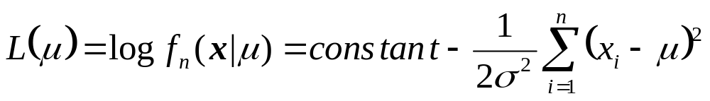

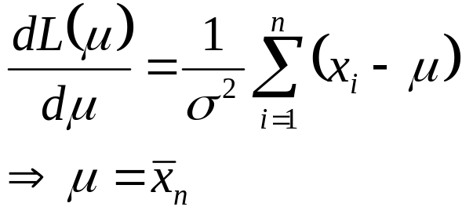
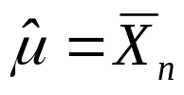
The logarithm of the likelihood function is
To find the value of μ which maximizes and thus maximizes L(μ),
So the M.L.E. of μ is

Slide 19
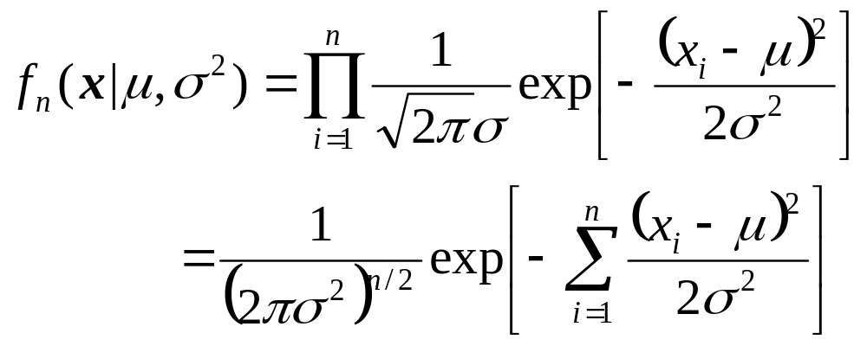
Example. Sampling from a Normal Distribution with Unknown Variance
Suppose that random variables X1,…,Xn form a random sample from a normal distribution for which both the mean μ and the variance are unknown.
For any observed values x1,…,xn, the likelihood function is

Slide 20
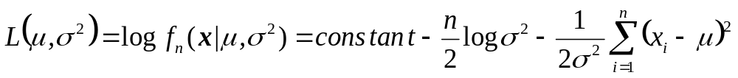
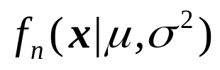

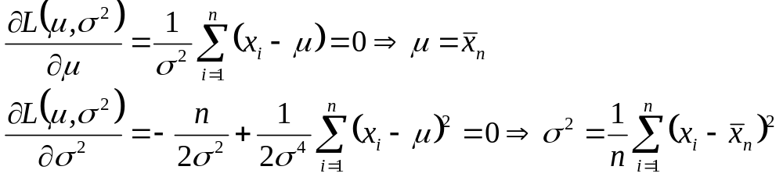
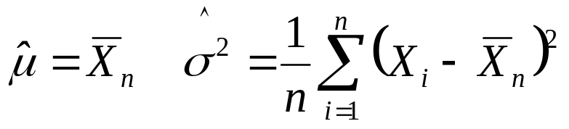
The logarithm of the likelihood function is
To find the value of μ and which maximizes and thus maximizes
So the M.L.E.’s of μ and are

Slide 21
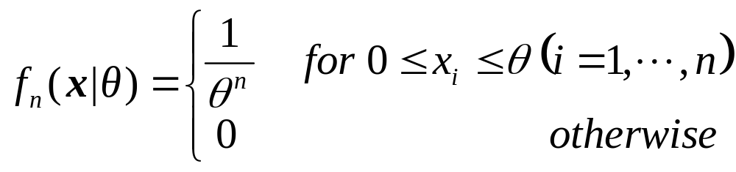
Example. Sampling from a Uniform Distribution
Suppose that random variables X1,…,Xn form a random sample from a uniform distribution on the interval [0,θ], where θ is unknown.
For any observed values x1,…,xn, the likelihood function is

Slide 22




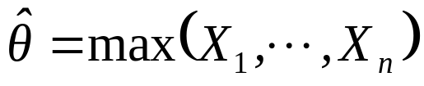
The value of θ which maximizes must be a value of θ for which for i=1,…,n and which maximizes among all such values.
This value is
So the M.L.E. of θ is

Slide 23

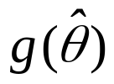
Properties of M.L.E.s
Invariance
Theorem. Let be an M.L.E. of θ, and let g(θ) be a function of θ. Then an M.L.E. of g(θ) is
Note: θ could be a single parameter or a parameter vector.

Slide 24

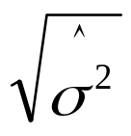
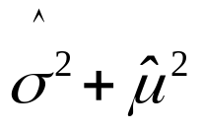
Example
Suppose that random variables X1,…,Xn form a random sample from a normal distribution for which both the mean μ and the variance are unknown. What are the M.L.E. of σ and the M.L.E. of the second moment ?
  The M.L.E.’s of μ and are
  From the invariance property, the M.L.E. of σ is
  and the M.L.E. of is

Slide 25

Consistency
Under certain conditions which are typically satisfied in practical problems, the sequence of M.L.E.’s converges in probability to the unknown value of θ as . We say that the M.L.E. is a consistent estimator of θ.

